Slide 1

CS-4053 Recommender System
Spring 2023
Lecture 8: Neural Networks (Part 1)
Course Instructor: Syed Zain Ul Hassan
National University of Computer and Emerging Sciences, Karachi
Email: zain.hassan@nu.edu.pk

Slide 2
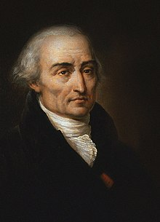
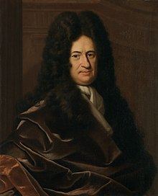
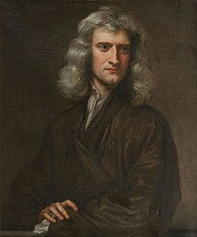
Derivatives: Recap
Joseph Lagrange
Gottfried Leibniz
Isaac Newton

Slide 3
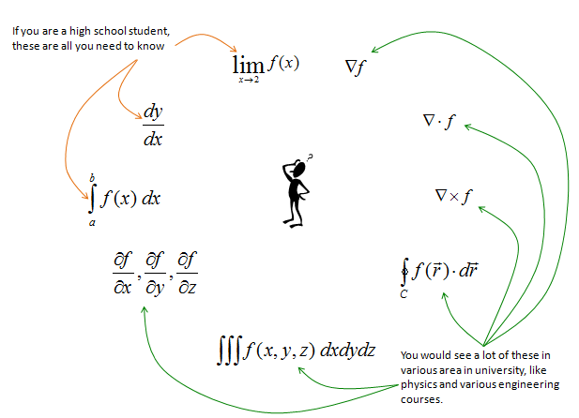
Derivatives: Recap
Idea: Intuition of derivatives will be enough

Slide 4

Derivatives: Recap
Imagine having an arcade machine
There is a certain game G1 that you like
To play this game you need coins
For every x coin, you get to play 2x minutes
So for 1 coin you play 1 minute
For 2 coins, you play 4 minutes and so on…

Slide 5
Derivatives: Recap
For coin x: 1, 2, 3, 4, 5
Play time: 2, 4, 6, 8, 10
For every change in coin quantity x, how much more play time we get? 2 more minutes

Slide 6

Derivatives: Recap
x: 1, 2, 3, 4, 5
f(x) = 2x : 2, 4, 6, 8, 10
Derivative of f(x) : $\frac{df(x)}{dx}=2$
“jump” in the value of y w.r.t change in value of x

Slide 7
Partial Derivatives: Recap
Let us assume we have 3 games on this machine
For every x coin, you get to play 2x minutes of G1
For every y coin, you get to play 3y minutes of G2
For every z coin, you get to play 5z minutes of G3
If we only have coins for G1, then G2 and G3 don’t matter to us
If we only have coins for G2, then G1 and G3 don’t matter to us
If we only have coins for G3, then G1 and G2 don’t matter to us

Slide 8
Partial Derivatives: Recap
A derivative taken w.r.t only one variable while treating the remaining variables as constants

Slide 9

Derivatives: Recap
x: 1, 2, 3, 4, 5
y: 1, 2, 3, 4, 5
z: 1, 2, 3, 4, 5
$f\left(x, y,z\right)=2x+3y+5z$
$\frac{∂f(x, y, z)}{∂x}=2$
$\frac{∂f(x, y, z)}{∂y}=3$
$\frac{∂f(x, y, z)}{∂z}=5$

Slide 10
Gradient: Recap
Let us assume we have 3 games on this machine
For every x coin, you get to play 2x minutes of G1
For every y coin, you get to play 3y minutes of G2
For every z coin, you get to play 5z minutes of G3
To “optimize” your gaming time, you need to decide coins for which games to use more i.e., you need to find the optimal values of x, y and z and see how much “change” that brings to your “overall” gaming time/ experience

Slide 11
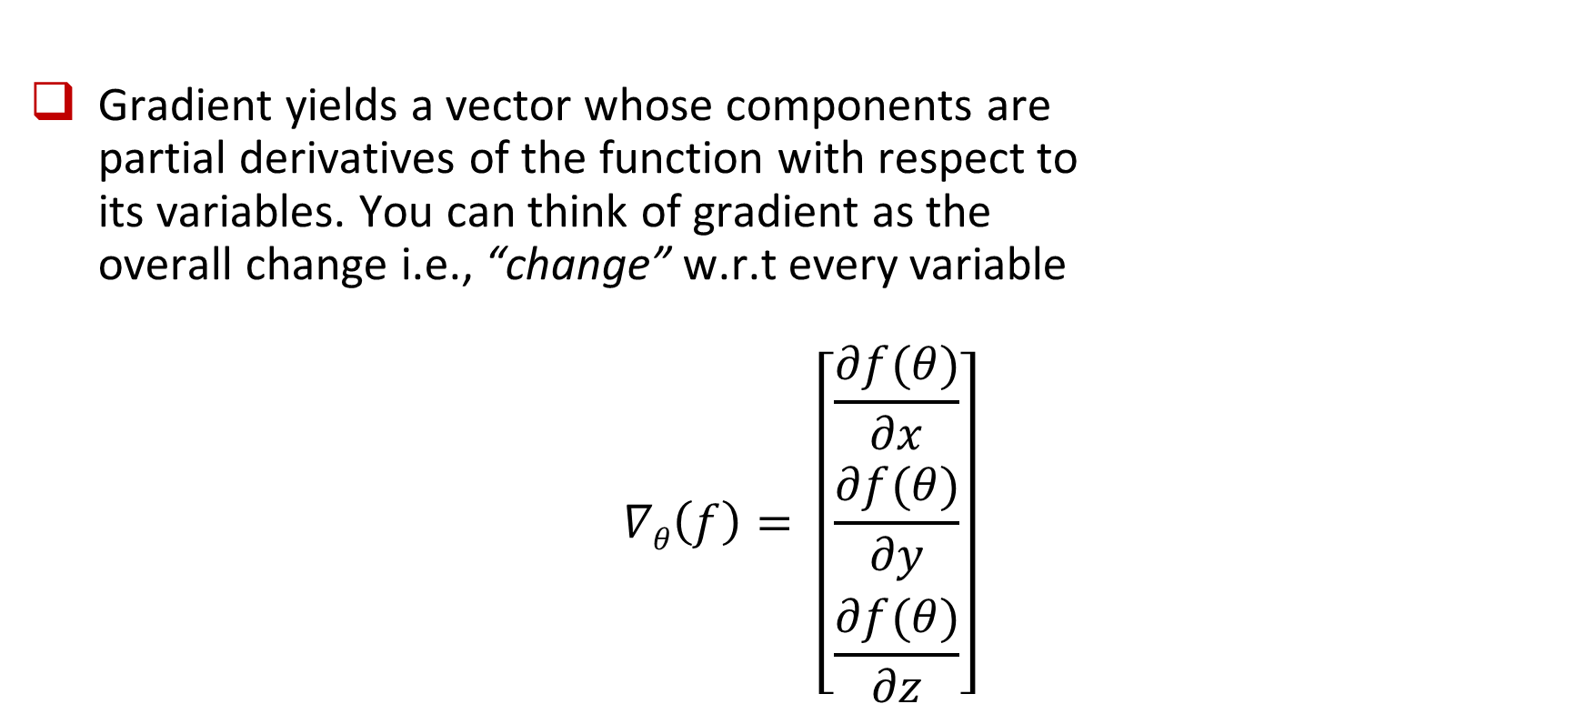
Gradient: Recap
Gradient yields a vector whose components are partial derivatives of the function with respect to its variables. You can think of gradient as the overall change i.e., “change” w.r.t every variable
$$∇θ\left(f\right)= \left[\begin{matrix}\frac{∂f(θ)}{∂x} \\ \frac{∂f(θ)}{∂y} \\ \frac{∂f(θ)}{∂z}\end{matrix}\right]$$

Slide 12
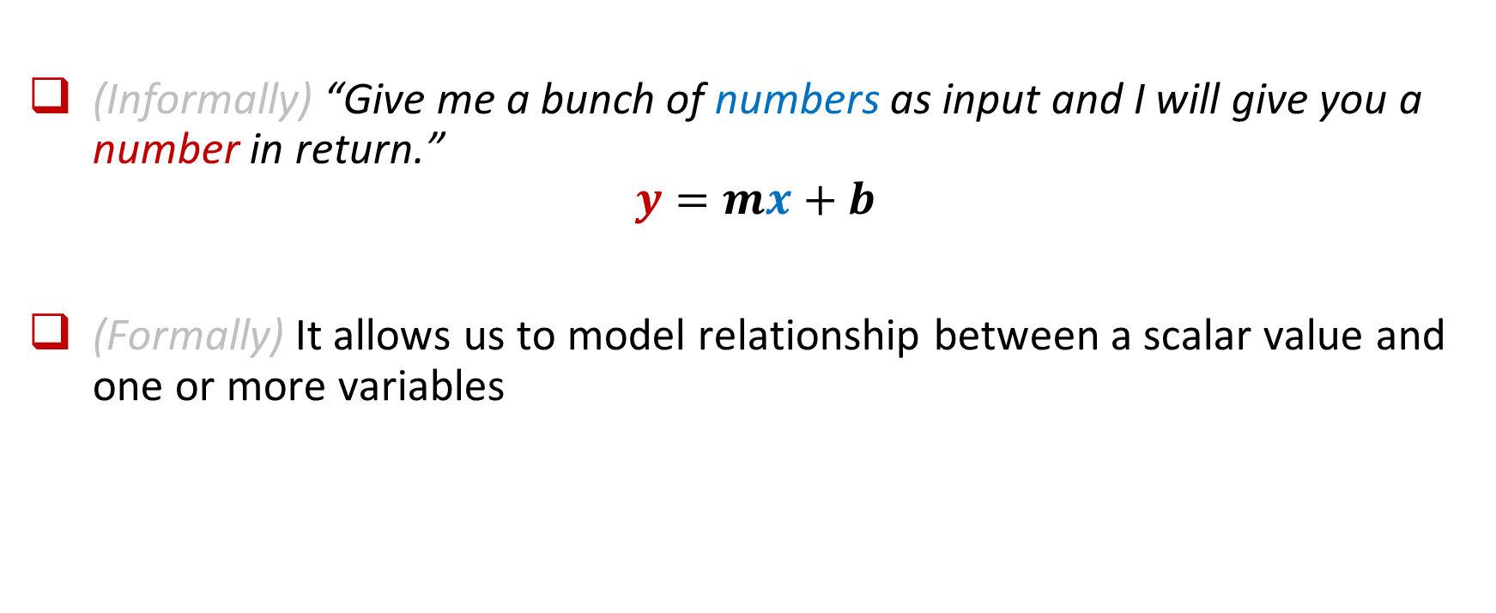
Linear Regression
(Informally) “Give me a bunch of numbers as input and I will give you a number in return.”
$$y=mx+b$$
(Formally) It allows us to model relationship between a scalar value and one or more variables

Slide 13

Linear Regression
Consider the following equation for m = 2 and b = 3:
$$y=mx+b=2x+3$$
For x = 1, y = 5
For x = 2, y = 7
For x = 3, y = 9
and so on…

Slide 14
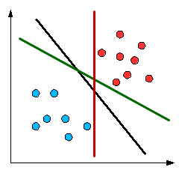
Issue: Linearly Separable Data
Let us assume that we have to “separate” the red and blue data points
We can essentially separate the given data into red and blue sets using a linear equation

Slide 15
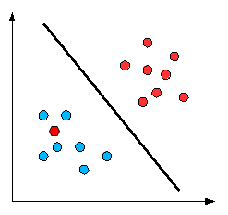
Issue: Linearly Separable Data
Unfortunately, we are not so lucky in reality
The data we have is rarely ever linearly separable hence a line is not enough to “separate” the given data points

Slide 16
Issue: Linearly Separable Data
We need non-linearity to separate these data points

Slide 17
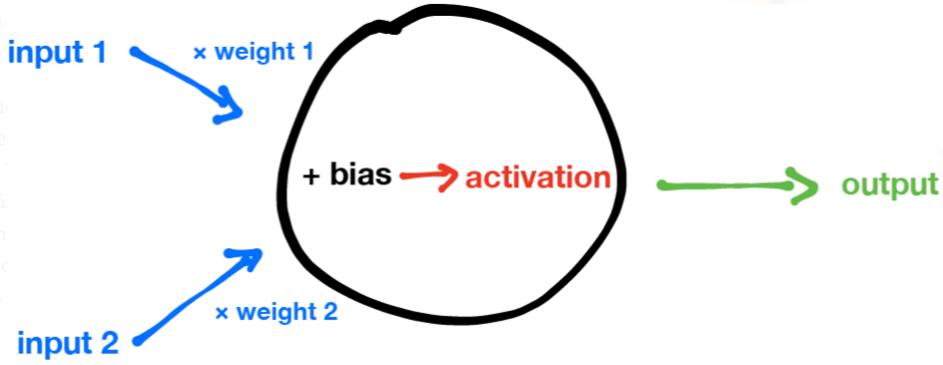
Neural Network: What is a Neuron?
A neuron takes any number of inputs and spits out an output

Slide 18

Neural Network: What is a Neuron?
If we ignore the activation, this neuron can be expressed as:
$$y=weight1∗input1+weight2 ∗input2+bias$$

Slide 19

Neural Network: What is a Neuron?
Without activation, we are performing regression with this neuron:
$$y=weight1∗input1+weight2 ∗input2+bias$$

Slide 20
Neural Network: What is an Activation?
A activation function adds non-linearity to the output of the neuron and helps decide whether the neuron should be “activated” or not

Slide 21
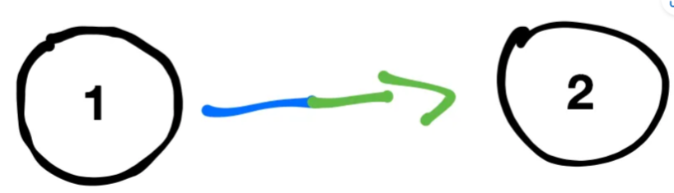
Neural Network: Why is it called a Network?
A single neuron doesn’t really help us find complex patterns (and is not cool enough!)
We need a network of inter-connected neurons to make complex decisions
The output of one neuron becomes the input of another neuron

Slide 22
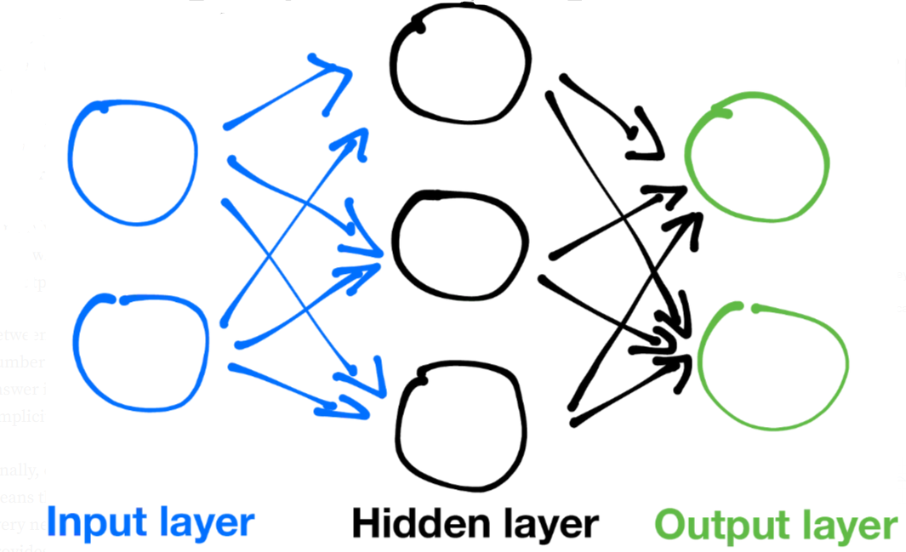
Neural Network: Architecture
A neural network is composed of layers of neurons

Slide 23
Neural Network: Architecture
A neural network is composed of fully-connected layers of neurons
In general, there are three types of layers: an input layer, one or more hidden layers, and an output layer

Slide 24
Neural Network: Architecture
The input layer will take on values of whatever the input is to the neural network
We can have our network take any number of inputs by changing the number of neurons in the input layer

Slide 25
Neural Network: Architecture
The output of the output layer will be the output of the whole neural network
We can change the number of neurons in the output layer to match the number of outputs we want

Slide 26
Neural Network: Architecture
Between the input layer and the output layer are hidden layers
We cannot generally know the number of hidden layers we should use (nice!)

Slide 27
Neural Network: How does it work?
If we want to identify a person we need to look for features
Which features are relevant (discriminative)?

Slide 28
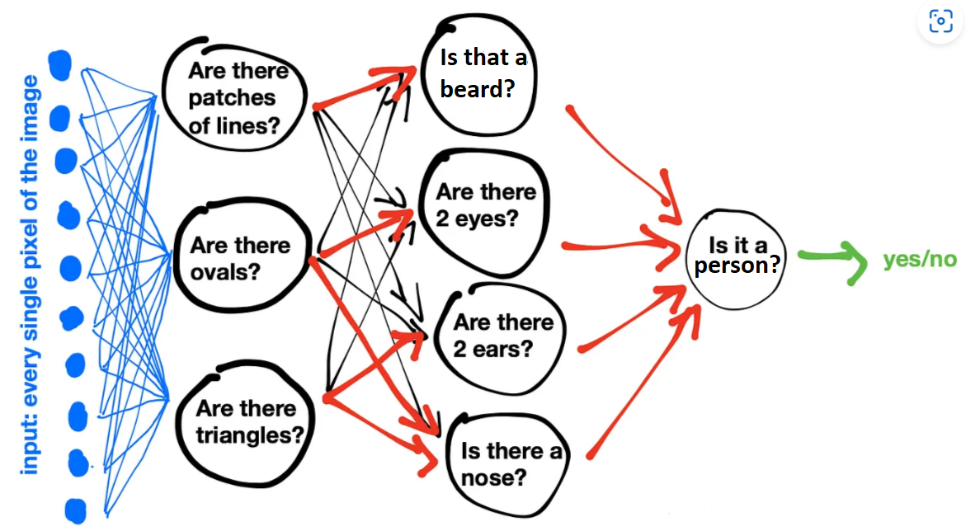
Neural Network: How does it work?

Slide 29
Neural Network: How does it work?
Notice that the neurons that are deeper ask more abstract questions about the features

Slide 30
Neural Network: Training
How do we train our neural network to identify a person?

Slide 31
Neural Network: Training
Feed raw input (features) to the input layer
Initialize all the weights and biases for hidden layers with random values
Test if the network can accurately produce the output
If it does not produce accurate results then adjust the weights and biases. It simply means we want to use optimization (e.g. gradient descent) to minimize the value of our loss function. Repeat Step 3
If it does produce accurate results then terminate training
To “adjust” the parameters (weights and biases) we use backpropagation

Slide 32
Neural Network: Training
When the neural network outputs the wrong answer, you find the slopes (derivative) of the output layer first because it was the direct cause of the incorrect answer
Since the output layer depends on the hidden layer, you’ll have to fix that too by finding the slopes and using gradient descent
Eventually you’ll work your way back (backpropagate) to the first hidden layer

Slide 33
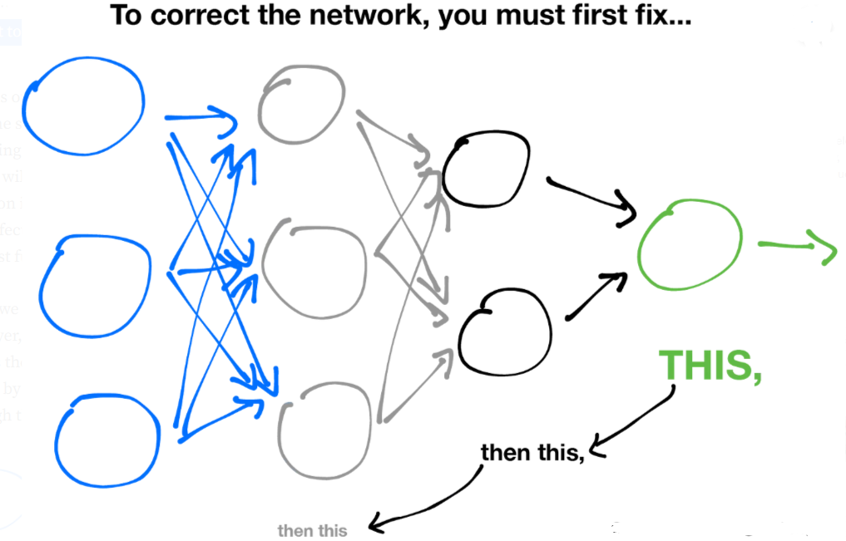
Neural Network: Backpropagation

Slide 34
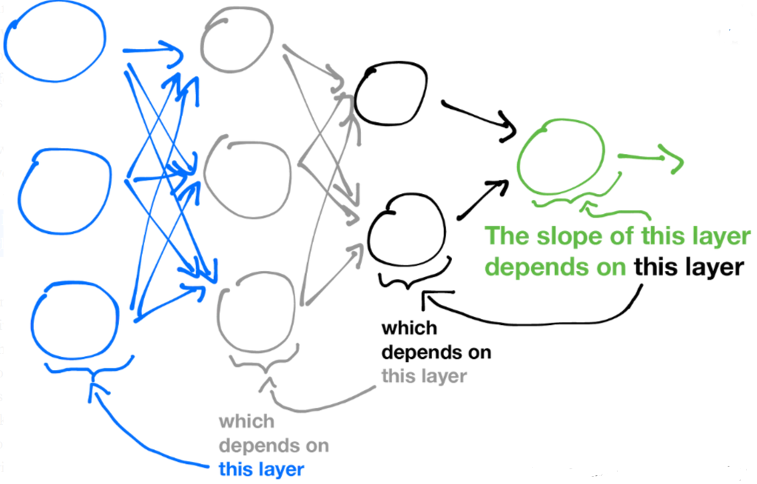
Neural Network: Backpropagation
We calculate slopes by starting from the back and moving backwards through the network until we get all the slopes for gradient descent

